Slide 1
Netflix Engagement Dataset
Submitted By—
Parivesh Rohilla (B.Tech AIML 2nd Yr)
Pawan Bhatt (B.Tech AIML 2nd Yr)
Shivank (B.Tech AIML 2nd Yr)

Slide 2
Introduction
Netflix is one of the world’s leading over-the-top (OTT) streaming platforms, offering a vast library of movies, series, and documentaries to millions of users across the globe. As competition in the streaming industry intensifies, understanding user behavior has become a strategic necessity.
User engagement—measured through metrics such as watch time, preferred genres, device usage, and churn rate—is crucial for tailoring content recommendations, improving user experience, and ensuring customer retention. Insights derived from such engagement data help platforms like Netflix refine their content strategy and marketing efforts.
This project leverages Microsoft Power BI, a powerful business intelligence tool, to transform raw Netflix engagement data into meaningful visual narratives. By utilizing interactive dashboards and dynamic charts, the project aims to uncover trends, patterns, and insights that can drive informed business decisions in the entertainment industry.

Slide 3
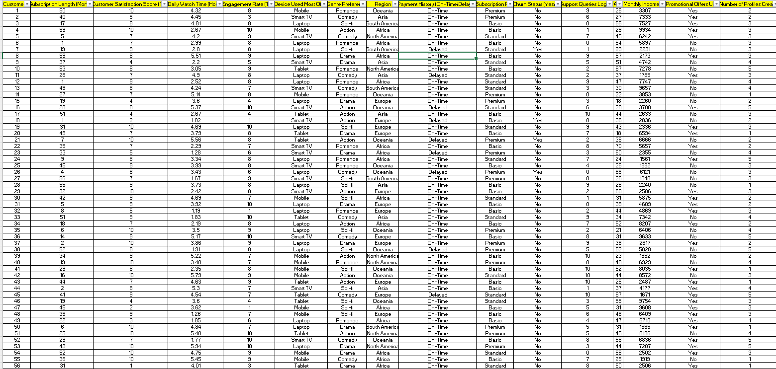
Given Netflix Engagement Dataset

Slide 4
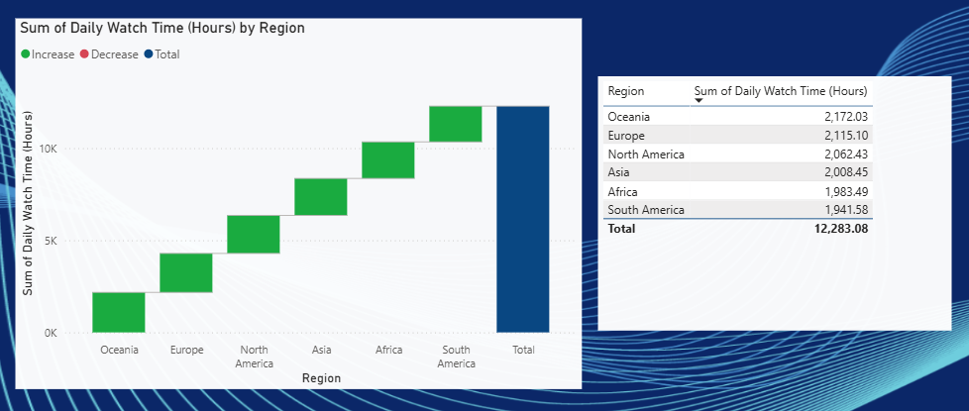
Final visual dashboard
Many graphs , filters , slicers and cards are being used in this dashboard so as to make it visually attractive and so that we can understand the data given easily and can make assumptions correctly.
Graphs used are
Bar chart, column chart, line chart, area chart, pie chart, doughnut chart, combo chart, scatter chart, waterfall chart, funnel, table, matrix, slicer, ......
Some Examples of graphs used
Bar Chart: Top genres by engagement
Line Chart: Watch time over months
Pie Chart: Subscription plan distribution
Treemap: Region-wise user count
KPI Card: Average watch time, churn rate
Funnel Chart: Support queries → Churn correlation

Slide 5
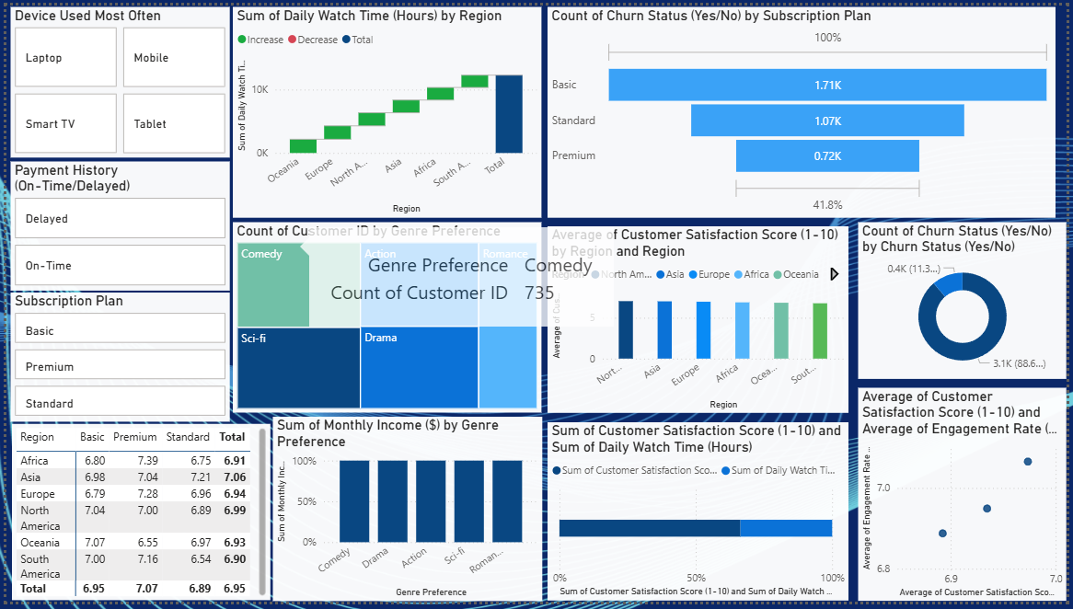
Dashboard 1

Slide 6
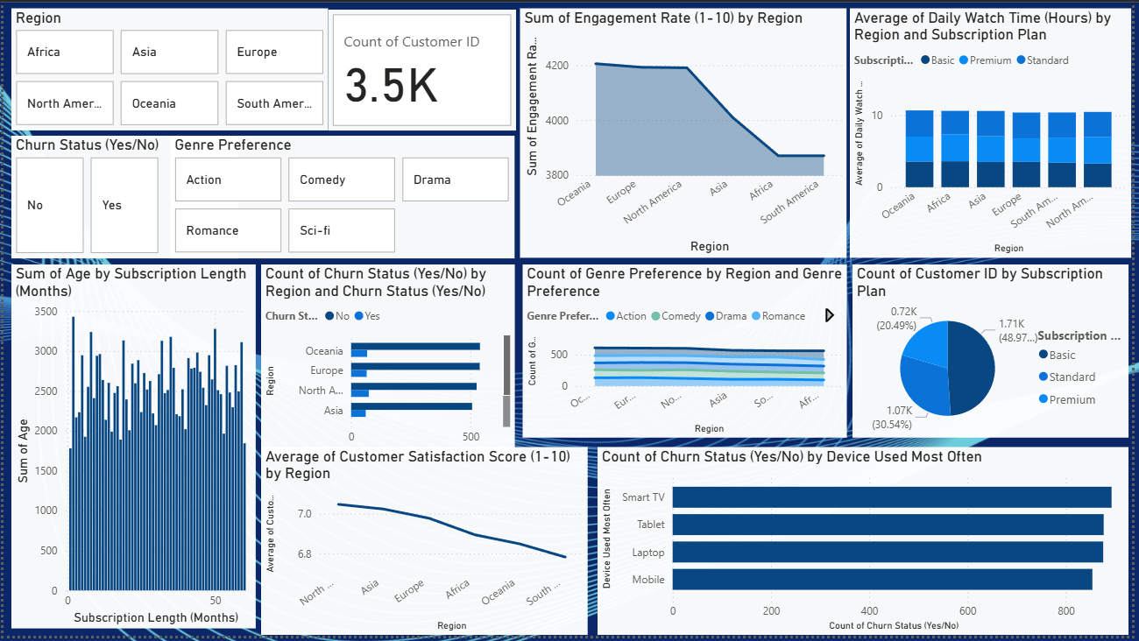
Dashboard 2

Slide 7
Thank You

